Slide 1
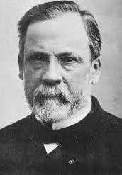
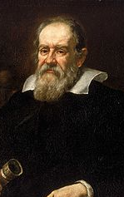
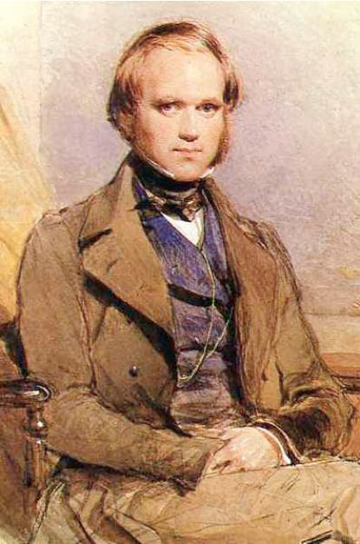
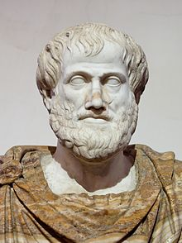

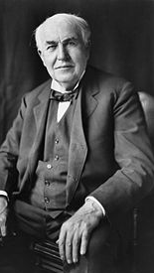
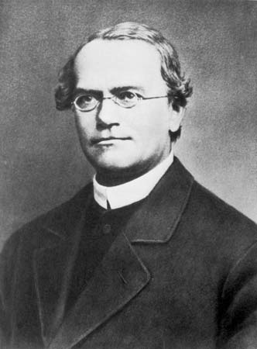
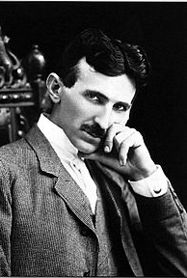
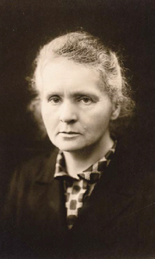
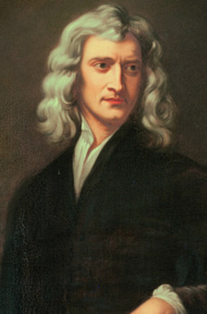
A
B
C
D
E
Consistently Ranked Among the “Top Ten” Scientists of All Time
F
G
H
I
J

Slide 2
Who Are They?
A)
B)
C)
D)
E)
F)
G)
H)
I)
J)

Slide 3
Who Are They?
A) Louis Pasteur
B) Galileo Galeli
C) Charles Darwin
D) Aristotle
E) Albert Einstein
F) Thomas Edison
G) Gregor Mendel
H) Nicola Tesla
I) Marie Curie
J) Isaac Newton

Slide 4
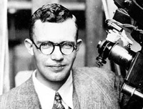
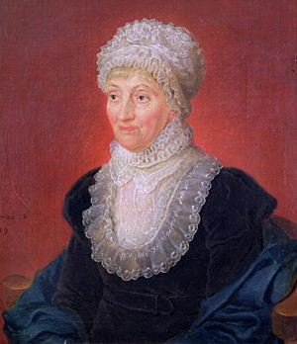
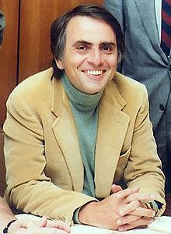
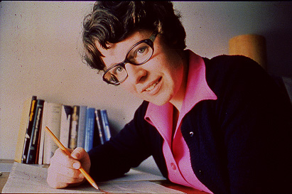
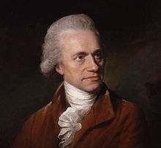
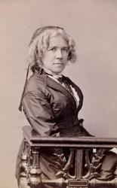

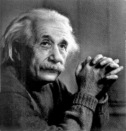
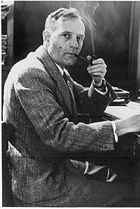
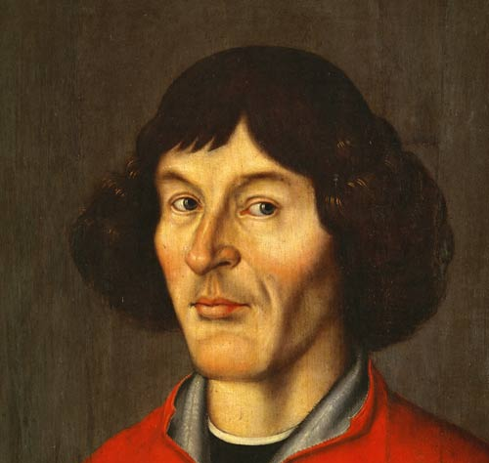
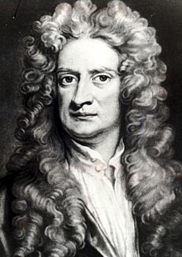
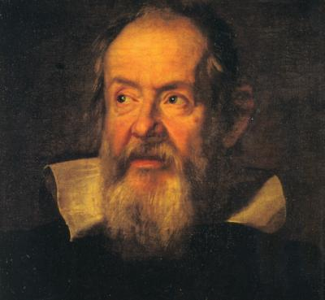
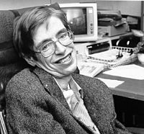
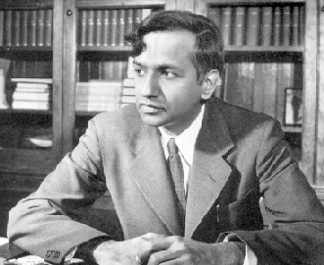
C
A
B
D
F
G
I
E
J
H
M
N
L
K

Slide 5
Who Are They?
A)
B)
C)
D)
E)
F)
G)
H)
I)
J)
K)
L)
M)
N)

Slide 6
Who Are They?
A) Clyde Tombaugh
B) Caroline Herschel
C) Carl Sagan
D) Jocelyn Bell Burnell
E) Maria Mitchell
F) Willian Herschel
G) Neil deGrasse Tyson
H) Albert Einstein
I) Edwin Hubble
J) Nicolas Copernicus
K) Subramayan Chandrasekhar
L) Steven Hawking
M)Isaac Newton
N) Galileo Galeli

Slide 7
Women in STEM

Slide 8
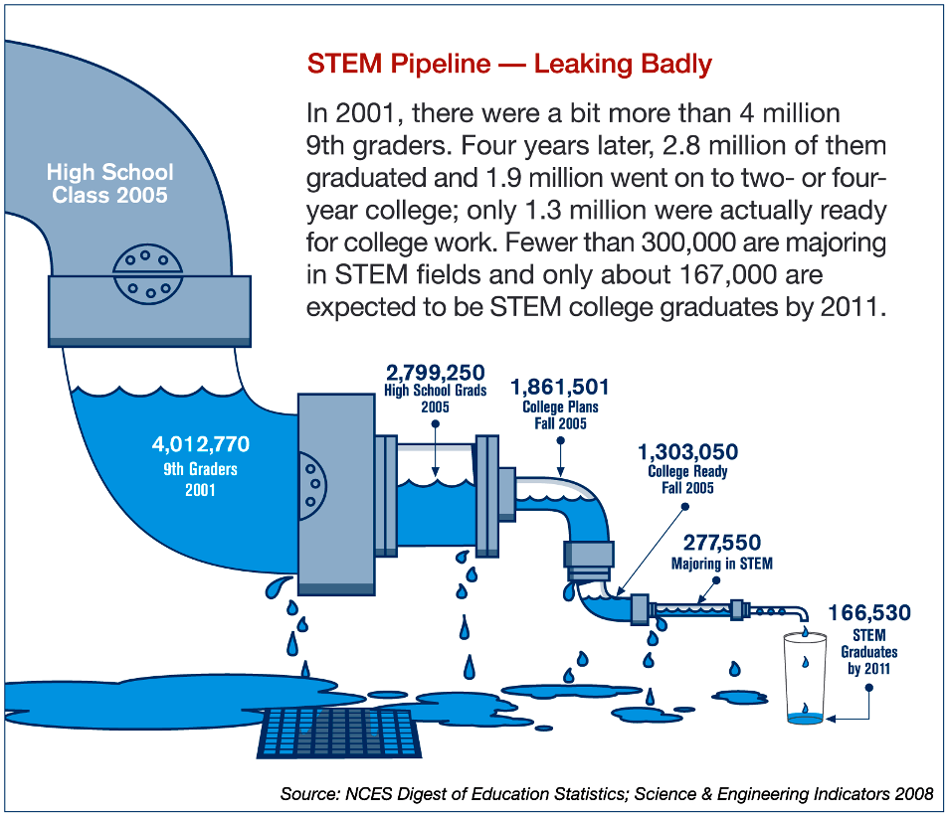

Slide 9
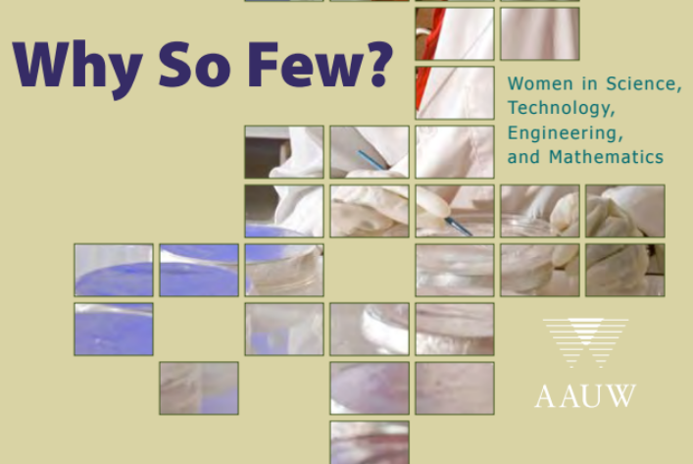
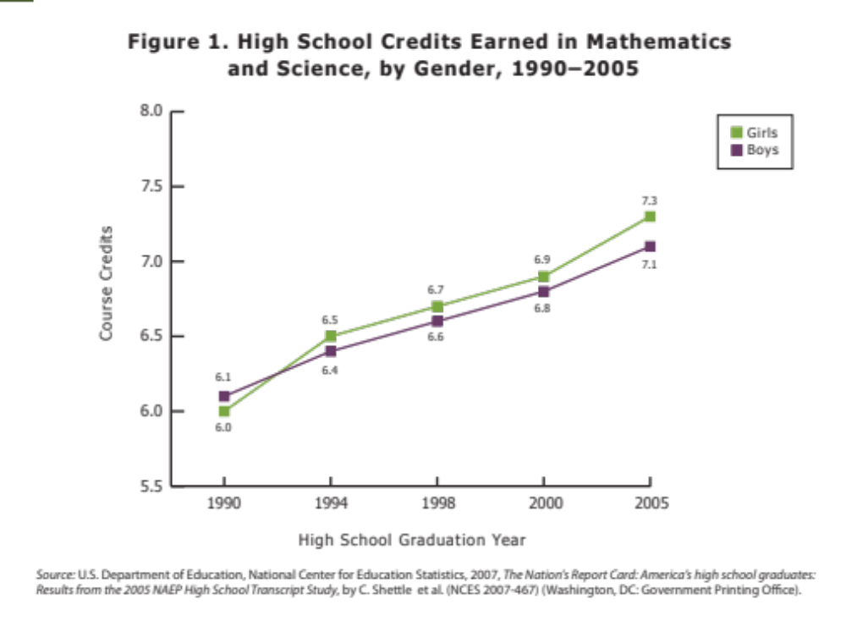
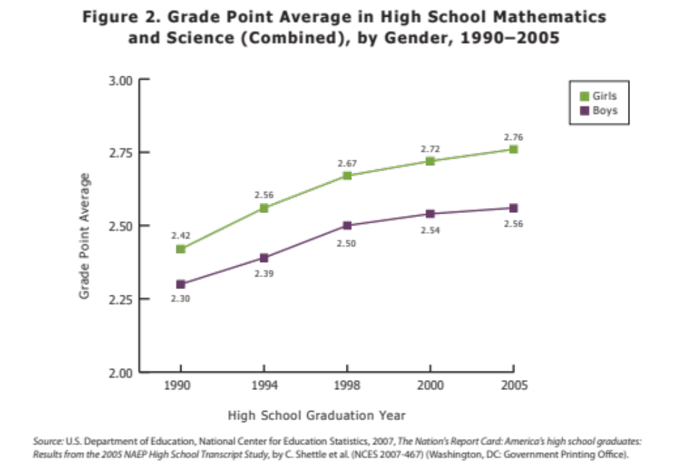
Women take more math, and perform better in High school

Slide 10
Interest

Slide 11
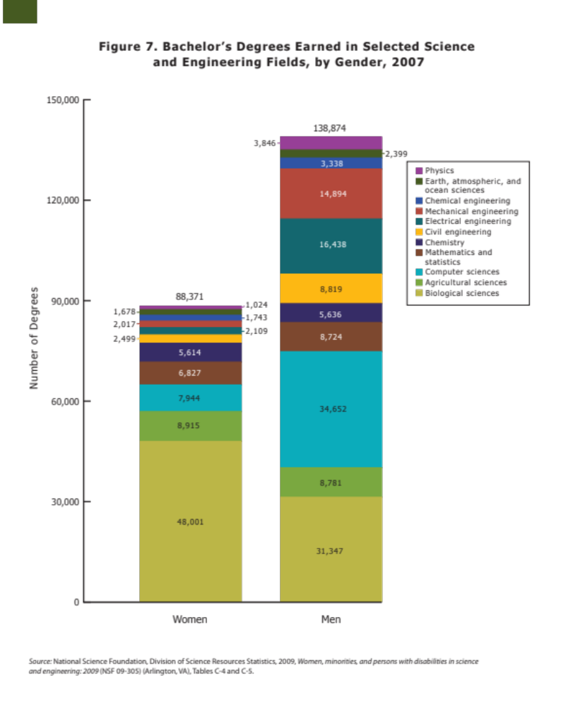
Women Physics Majors = 1024/227245=0.45% of STEM graduates
Men Physics Majors = 3846/227245=1.69% of STEM graduates
2007 Physics Bachelors Degrees:
1024/4870=21% Women
3846/4870=79% Men

Slide 12
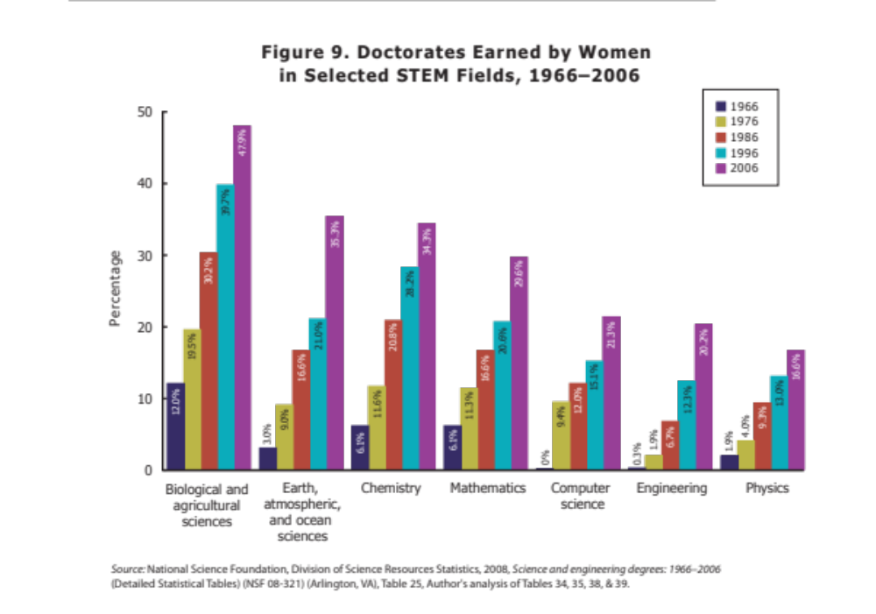
2007 Physics Bachelors Degrees:
1024/4870=21% Women
3846/4870=79% Men
Physics Doctorates:
16.6% women in 2006

Slide 13
2007 Physics Bachelors Degrees:
1024/4870=21% Women
3846/4870=79% Men
Physics Doctorates:
16.6% women in 2006
Extrapolate to 2013 for 2007 cohort of Physics bachelors degrees: 19.3% Women

Slide 14
How long until women are 50% of Physics doctorates?

Slide 15
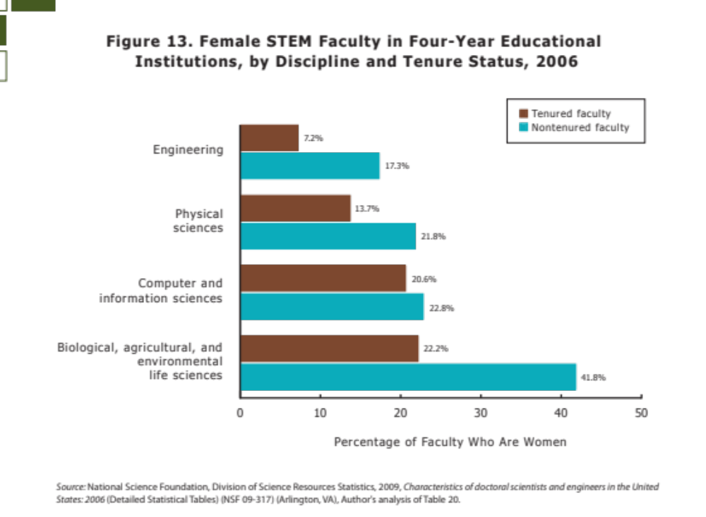

Slide 16
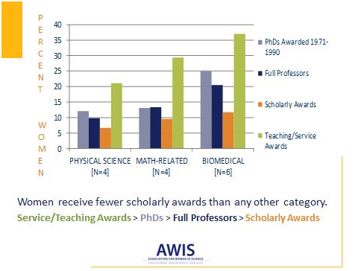
Faculty Recognition

Slide 17
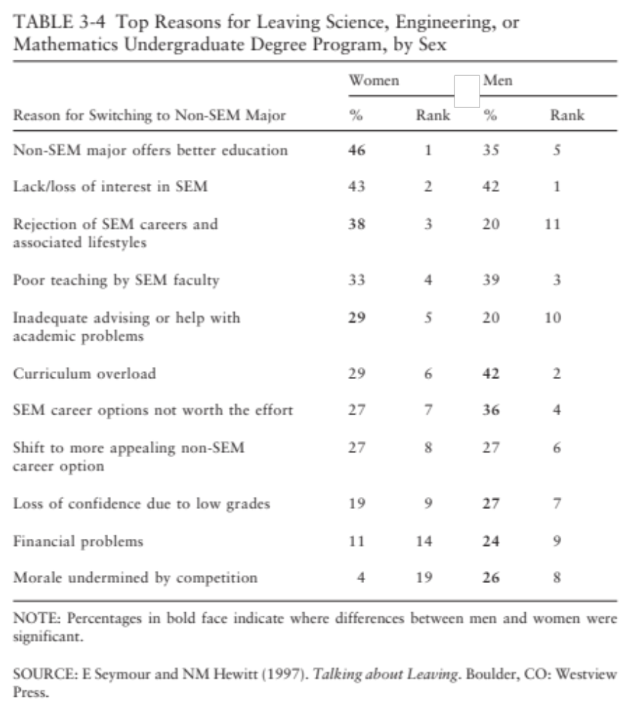
Proportion of men and women citing this reason same (to within statistical significance)
Women more likely to cite this reason for leaving STEM
Men more likely to cite this reason for leaving STEM

Slide 18
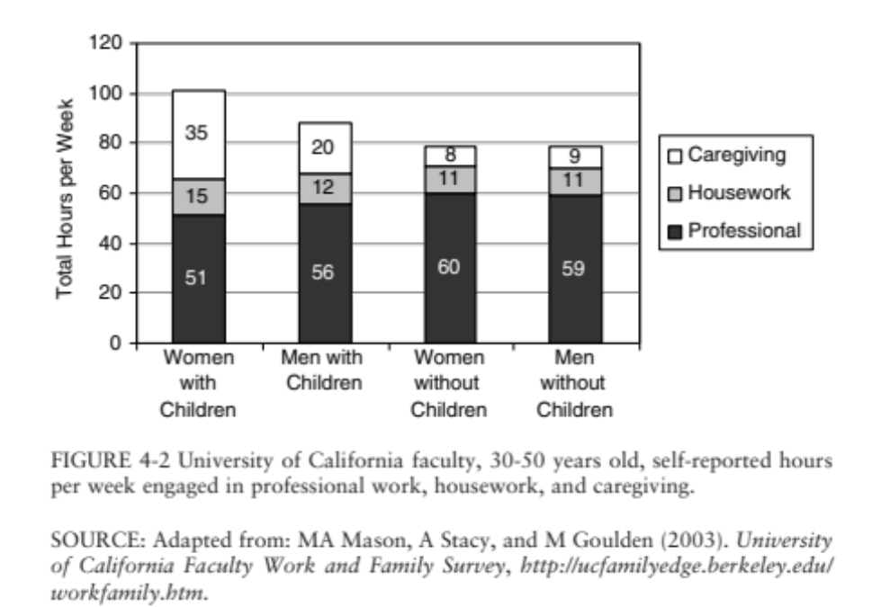
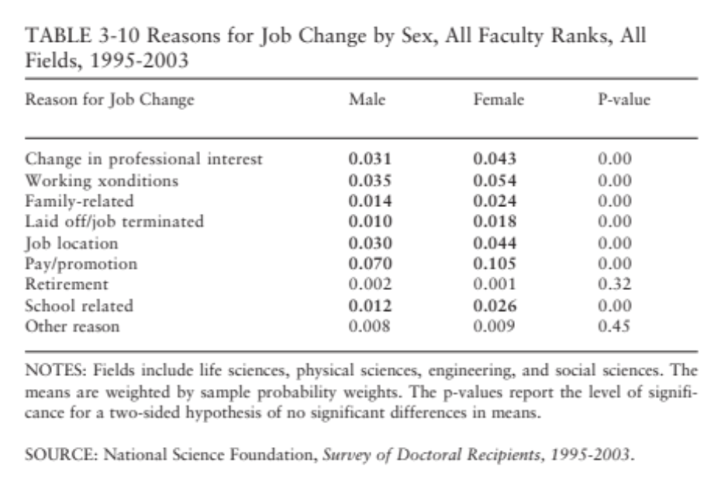

Slide 19
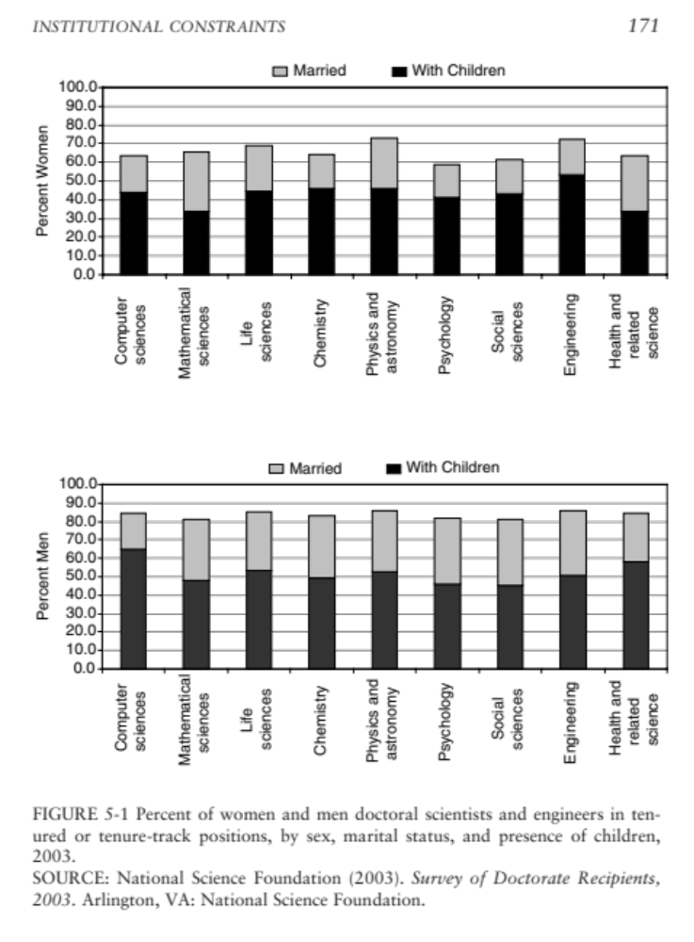

Slide 20
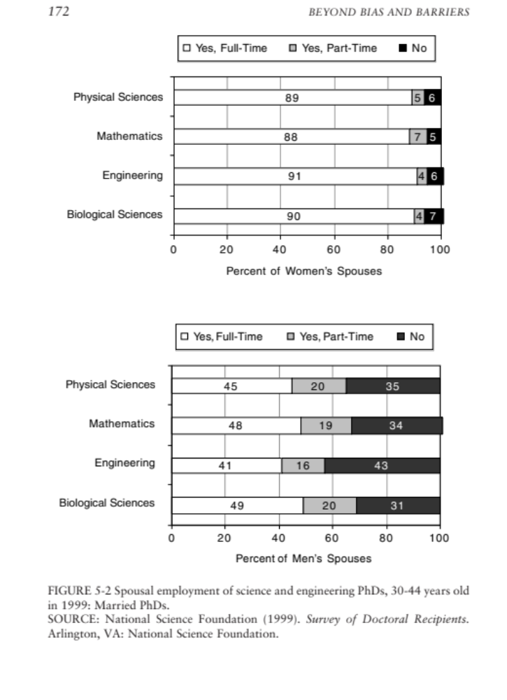

Slide 21
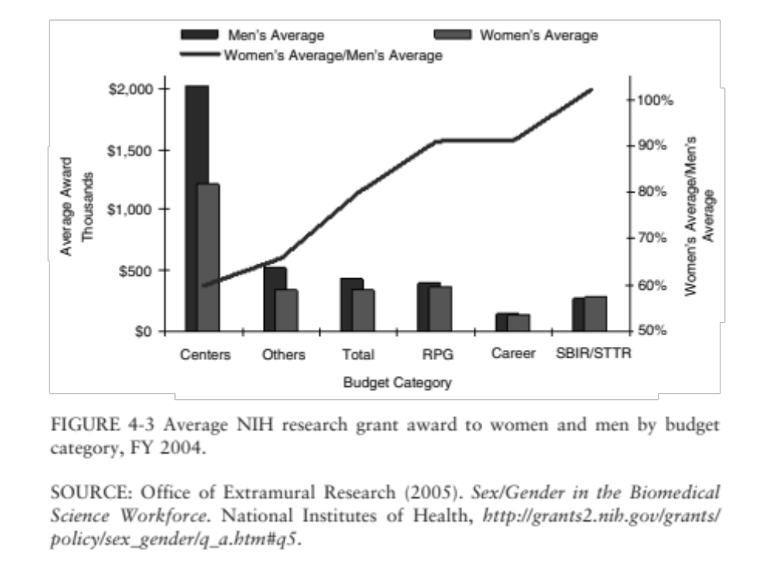
Notes:
Centers = women applying as lead from science center (vs individual investigator grants)
RPG = research program grants
SBIR/STTR=small business grants

Slide 22
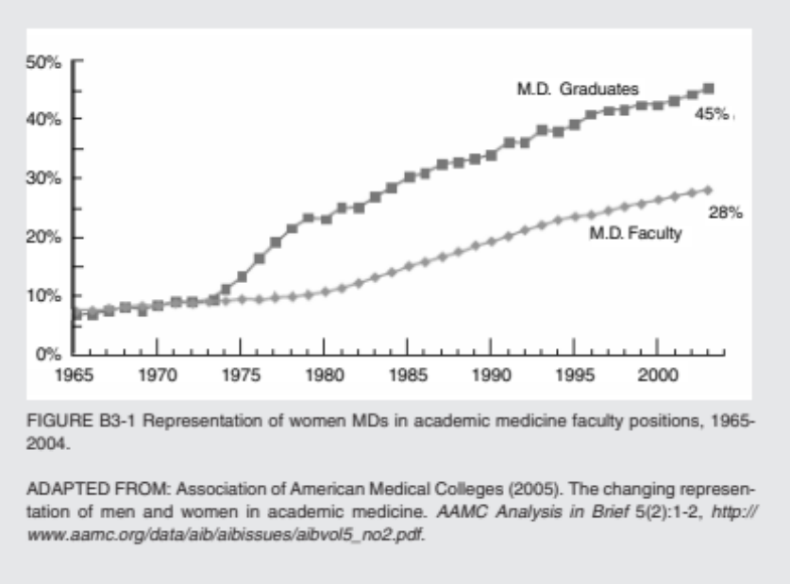

Slide 23
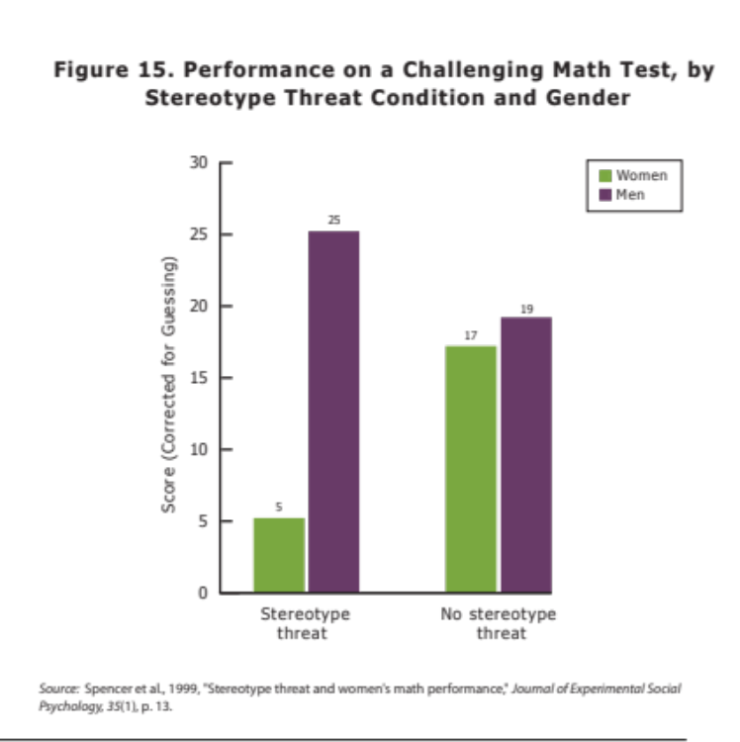
Stereotype Threat
Spencer et al 1999
54 University of Michigan psychology students (30 women, 24 men)
ALL with strong math backgrounds
ALL with similar math abilities (grades and standardized test scores)
2 groups given same computerized math exam
  Group 1 told that men outperform women
  Group 2 told no gender performance differences
300+ studies subsequently published to support this finding

Slide 24
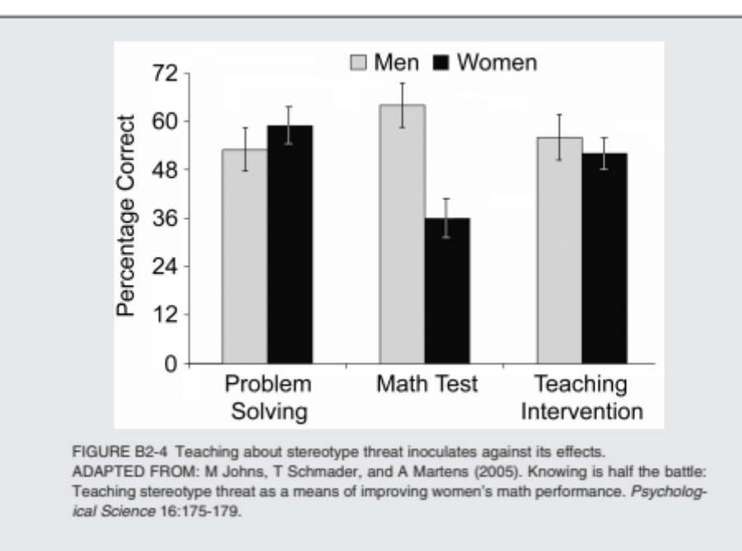
Stereotype Threat: High Pressure Situations and Interventions
Johns et al 2005
Three Groups given the same problems
  Group 1 told “problem solving exercise”
  Group 2 told “diagnostic test of math ability”, would be used to compare men’s and women’s scores
  Group 3 same as Group 2, but also informed of stereotype threat, told that anxiety felt during test may be result of external stereotypes

Slide 25
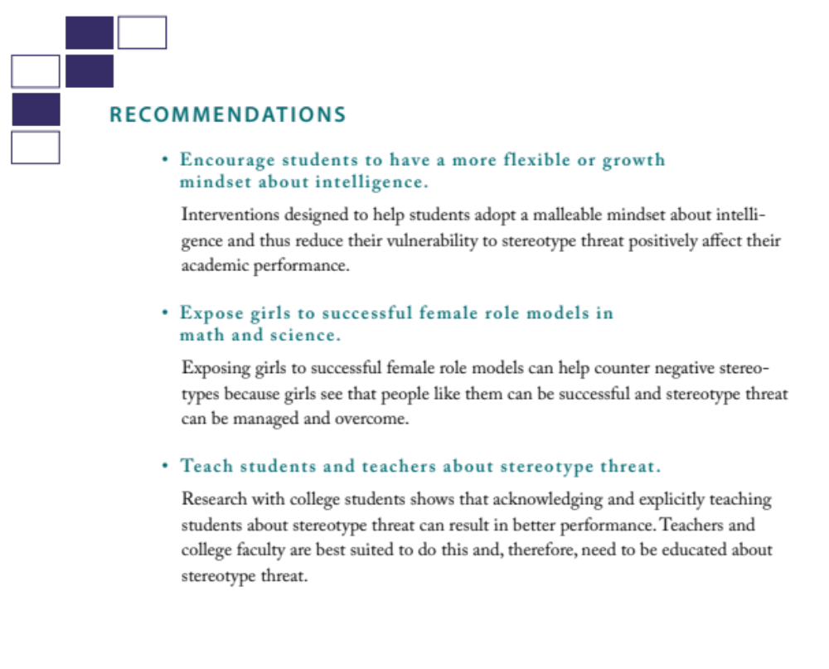
Stereotype Threat
Induced by:
1) Telling students that men outperform women
2) Asking students to indicate gender before test
3) Having more men than women in testing situation

Slide 26
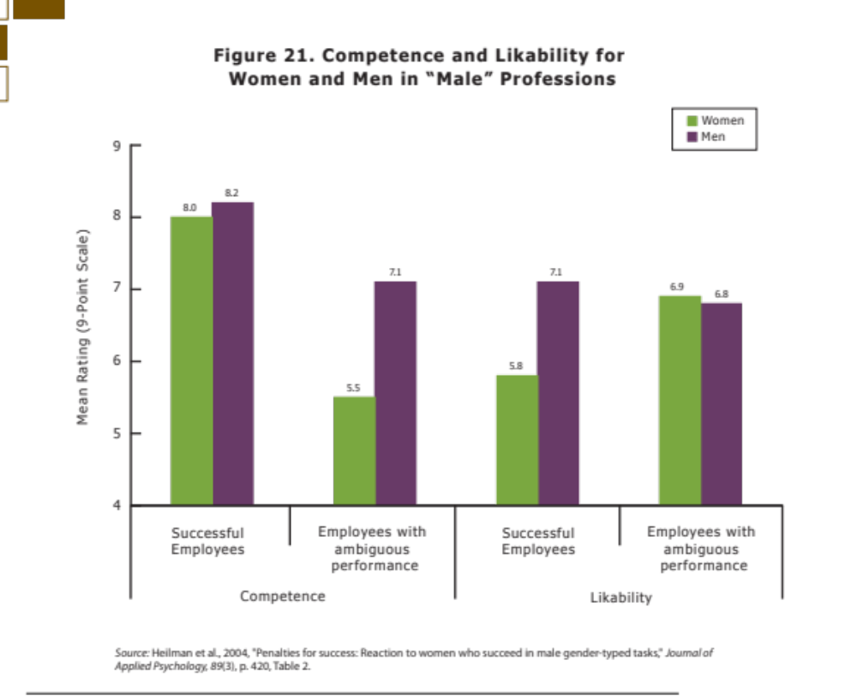
Unconscious/Implicit Bias

Slide 27
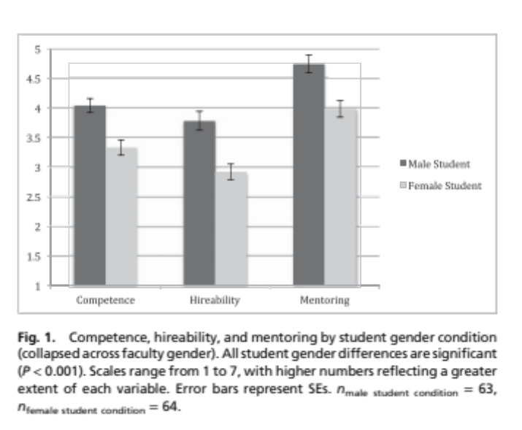
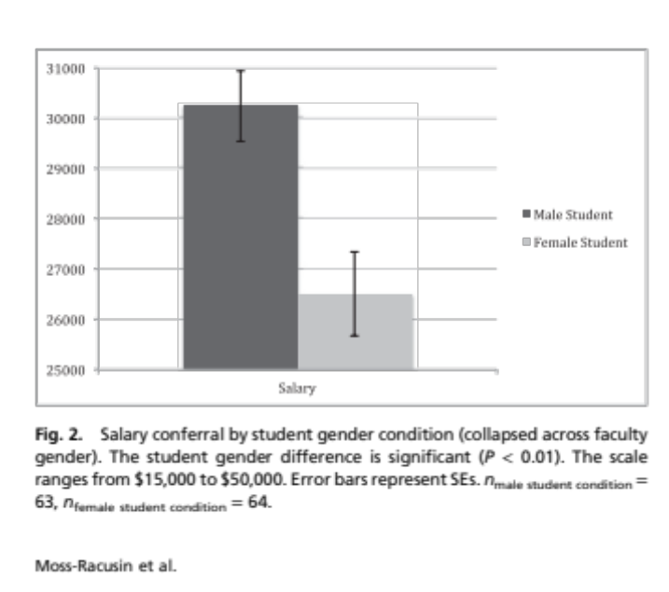
Unconscious/Implicit Bias: Resume Studies
Regardless of faculty gender!
Moss-Racusin et al. 2012
127 Biology, Chemistry and Physics Professors
Resume of one undergraduate student applying for science lab manager position
All resumes identical, but half given female name, half male
Faculty rate competence and hireability, indicate how much mentoring the student deserves and estimate starting salry

Slide 28
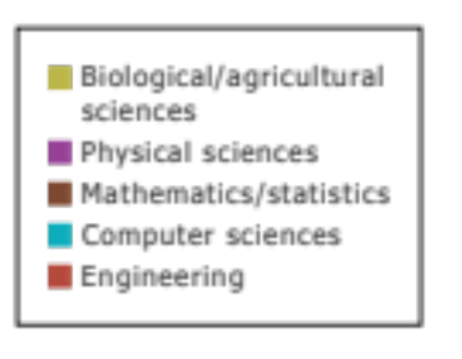
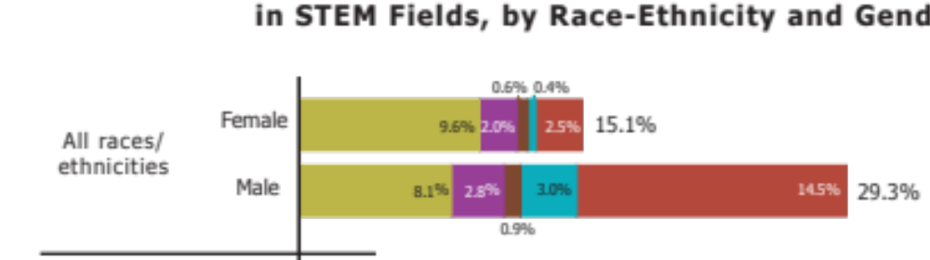

Slide 32
Resources
Beyond Bias and Barriers: Fulfilling the Potential of Women in Academic Science and Engineering http://www.nap.edu/catalog/11741.html
MIT Report on Women in Science

